Slide 1

NEWTON’s Three Laws
FISIKA DASAR 1

Slide 2
Newton’s Law
Summary
Overview
Adopted from MIT Course

Slide 3
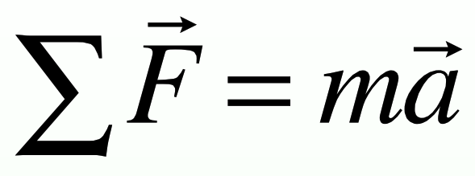
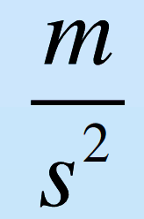
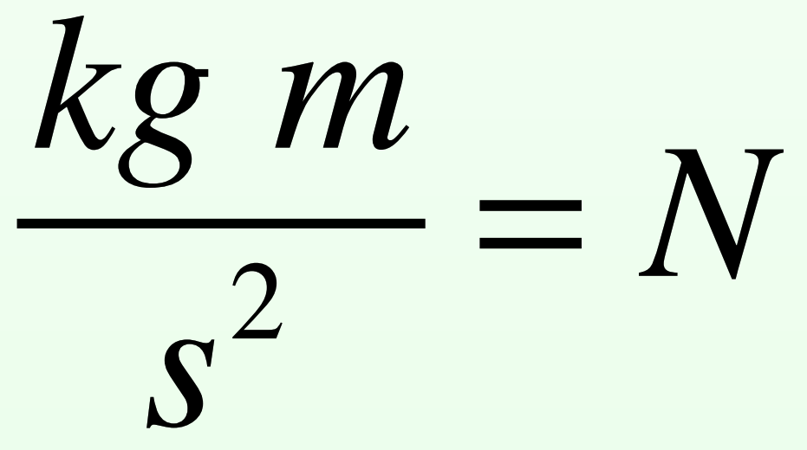

Newton’s First Law
Newton’s Second Law
NEWTON’s Three Laws
Newton’s Third Law
Objects move at constant velocity (and remain at rest if they start at rest) if they are acted on by no net external force.
The most confusing of them all!
Force due to object A on object B is always exactly equal in magnitude and always exactly opposite in direction to the force due to object B on object A.
Everything else we will do in 8.01L is an example or a consequence of this equation.
Force add as Vectors
The total force points in the direction of the acceleration
The force and acceleration are related by m, a property of the object itself. Basically, how much “stuff” is there.
Constant velocity means both magnitude and direction
No net force doesn’t mean no force at all, just that whatever forces are present add up to zero
Only forces between objects, not internal forces count
This works both ways, if v is constant, then ΣF must be zero and if ΣF=0, then v must be constant.
The two forces are called an “action-reaction” pair
The two forces are equal and opposite in direction but do not “add to zero and go away” in solving problems because they act of different objects
It only makes sense to add forces on a single object
If you consider A+B as a single object, then these forces become “internal” and do drop out
Units of Force
Bring your business to the next Level with Powerfull presentation material for all business
Acceleration is
Force is
Adopted from MIT Course

Slide 4
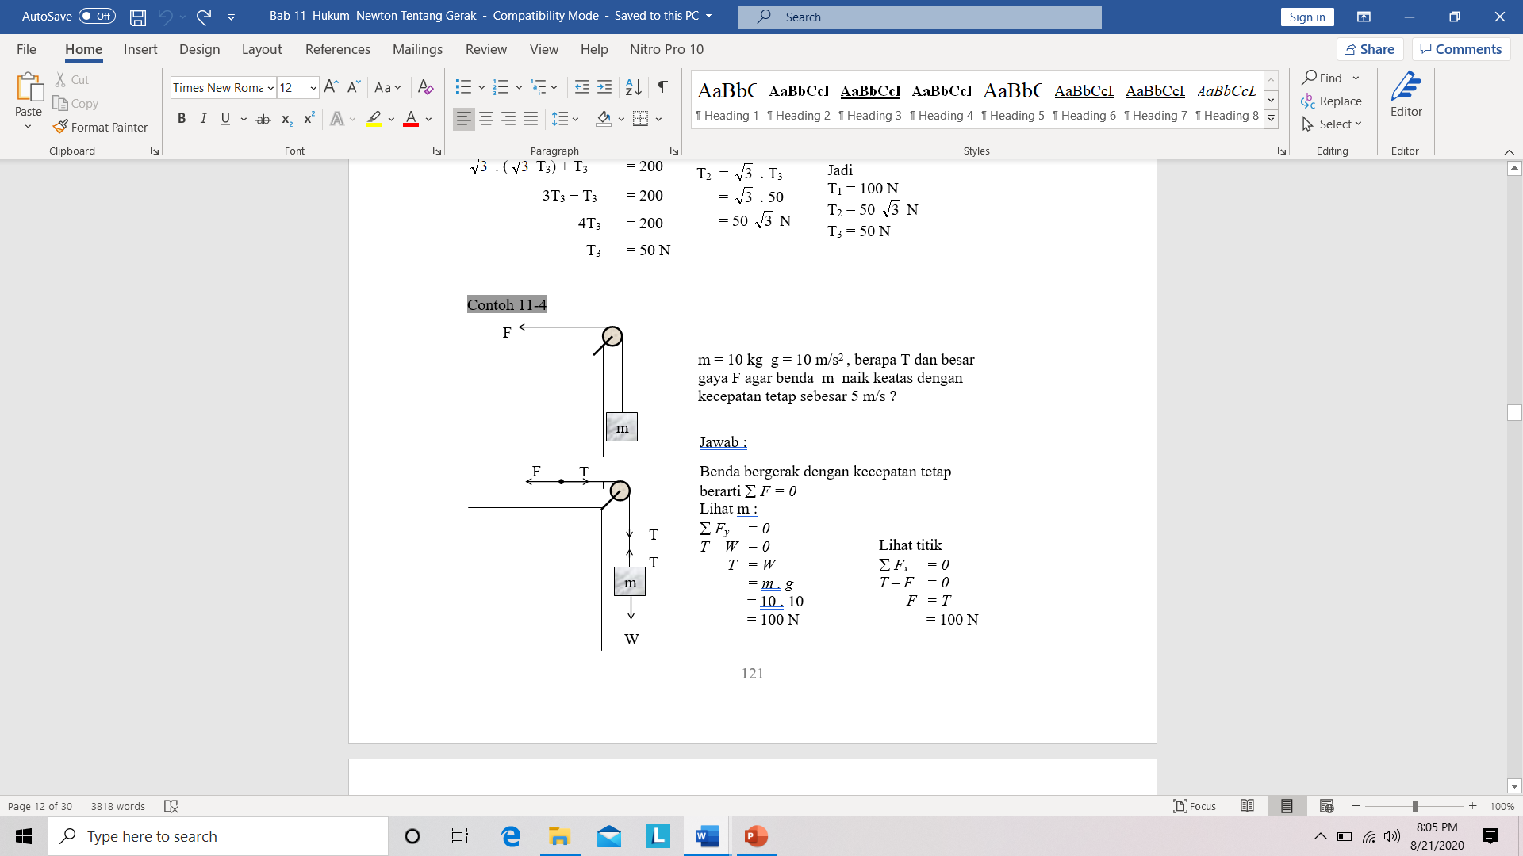
Example 1: HK.Newton I
2. Terapkan hukum Newton
1. Menggambar diagram benda bebas

Slide 5
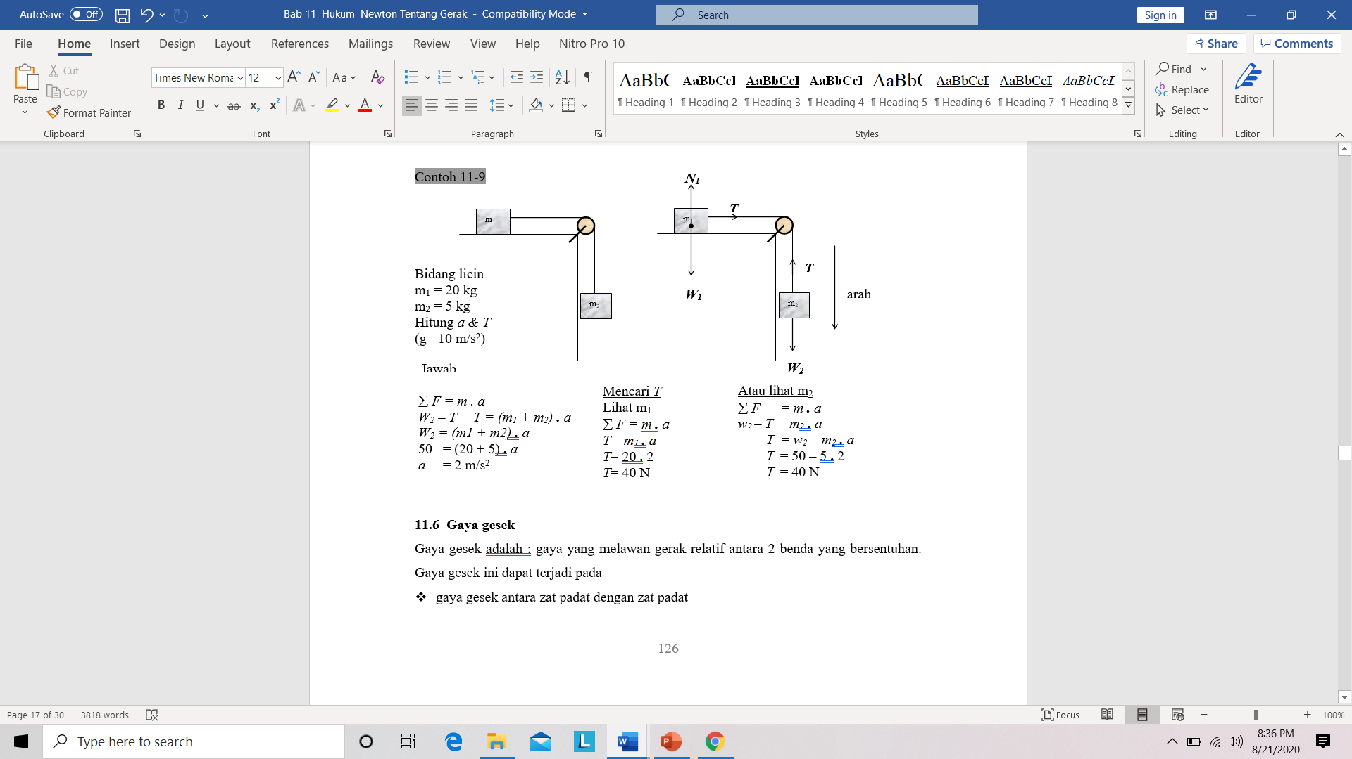
Example 2: Hk. Newton II
1. Menggambar diagram benda bebas
2. Terapkan hukum Newton

Slide 6
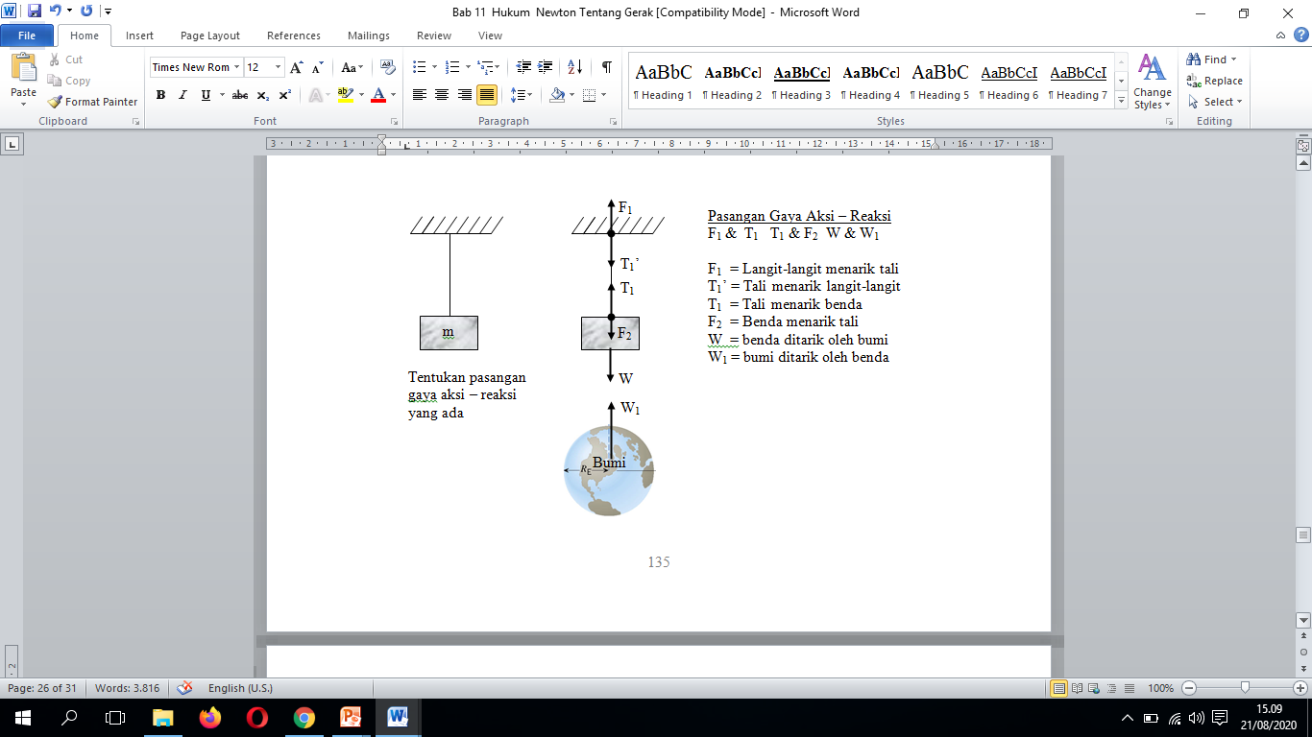
Example 3: HK Newton III

Slide 7

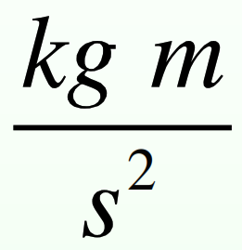
Inertial Reference Frames
SUMMARY
Force is related to the change in the velocity vector
Cc
The unit of force is the Newton which equals
Action-reaction pairs are an important concept in solving problems but need to be considered very carefully, especially the fact that the two forces in the pair act on different objects
These concepts only apply as phrased here in inertial reference frames
These principles only apply for observers who are not accelerating, a so-called “inertial” frame
There are philosophical objections to this concept since it’s hard to precisely define an inertial frame except as one where Newton’s Laws are valid
Alternative formulations are beyond the scope of this course, you don’t need to worry about it
Adopted from MIT Course

Slide 8
THANK YOU

